Slide 1

链家地产在中国
Homelink in China

Slide 2
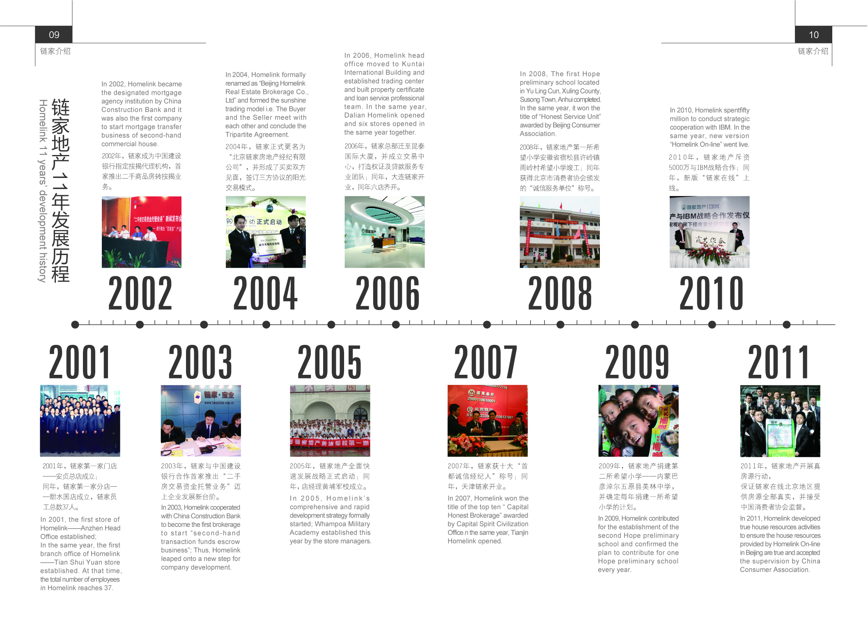

Slide 3
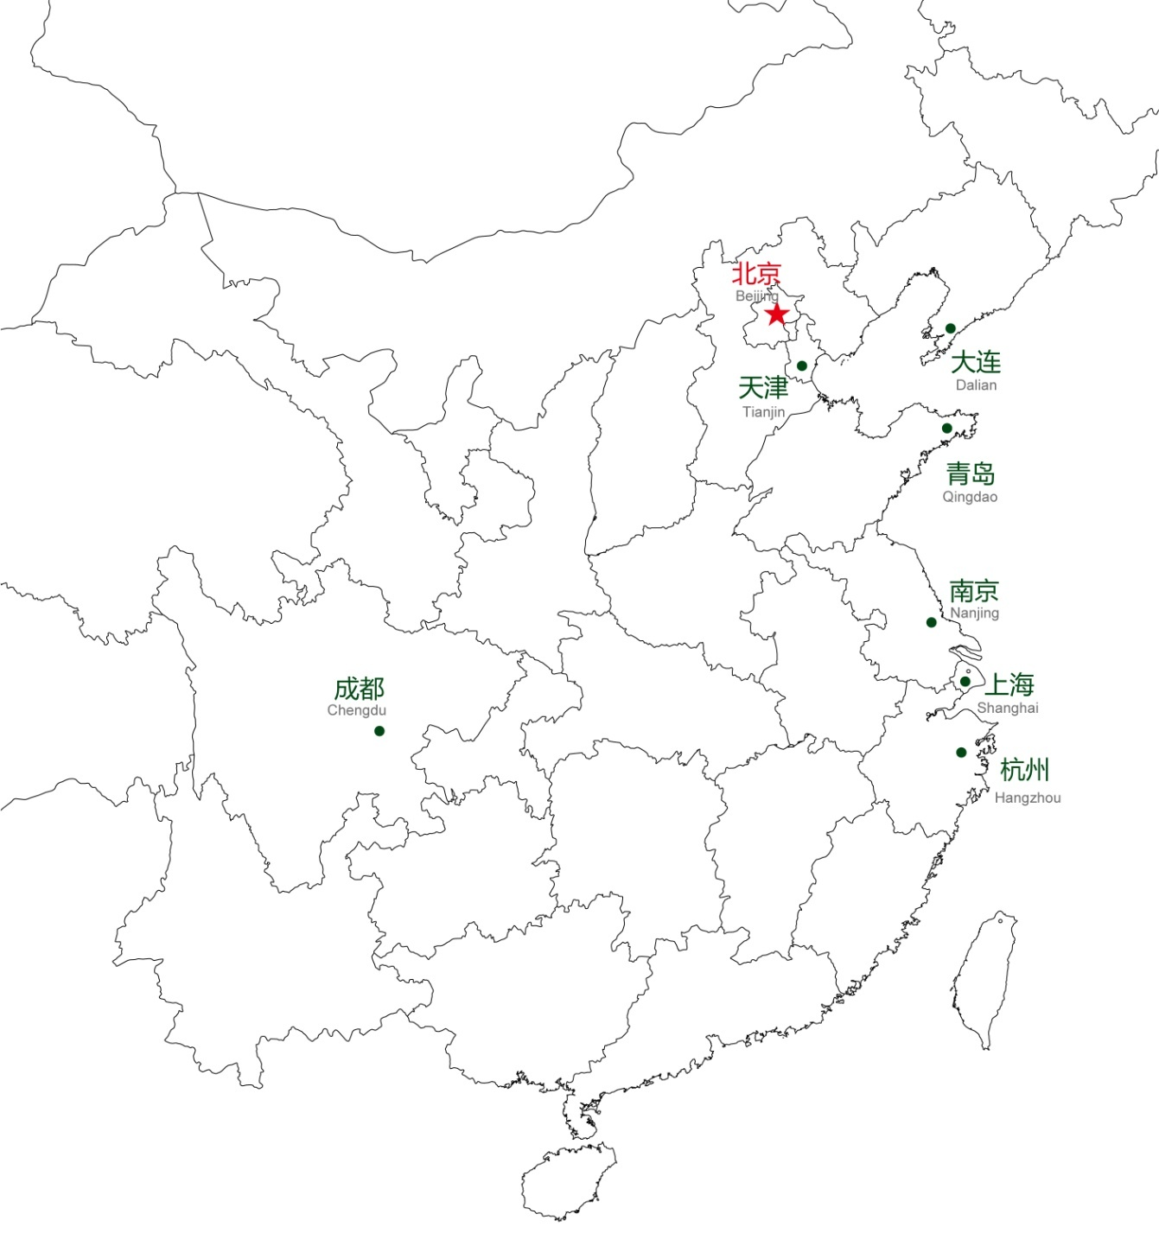

链家地产是中国领先的不动产服务提供商，致力于为客户提供优质的房地产经纪、金融及资产管理等服务，让每一位消费者都能在链家愉悦的找到一个家。
业务范围：横跨华北、东北、华东、西南等经济区，并仍不断扩大服务区域。
规模：1000余家直营连锁门店和26000多置业顾问，2012年销售额超过1100亿元，佣金额超过33亿元。
Homelink is the leading real estate service providers and engages in providing such high quality services as real estate agent, financial and capital management, etc. Homelink will satisfy each consumer to find a house in Homelink cheerfully.
Business ranges across such economic areas in North China, Northeast China, Eastern China and Southwest China, etc and is still expanding. Until 2012, Homelink owns more than 1000 regular chain stores, more than 26000 staff. Annual sales exceed RMB 110,000,000,000, the commission charges exceed RMB3,300,000,000.

Slide 4

链家愿景
“行业的领导者”让不动产服务业走进殿堂
链家使命
对社会：链家建立一个有远大抱负，操守自律，勇于创新，智慧管理的现代服务品牌。
对房地产交易客户：链家有能力并且渴望具备能力去给客户提供愉悦的不动产服务。
对房地产经纪行业：链家将提供海量、准确、标准、有深度、使用便捷的不动产资讯。
对房地产经纪人：链家帮助和鼓励经纪人用美好人性(诚实\正直\友善)来共同创造和分享属于平凡人的尊严和非凡成就。

Slide 5

链家价值观
客户至上：我们知道链家的存在对有房地产需求的客户来讲，意味着我们是值得信赖和依靠的。
诚实可信：我们可以没有聪明的脑袋、漂亮的脸蛋、绚丽的背景，但我们诚实，我们让人信任。
团队作战：我们正是因为自认在竞争中很弱小才走到一起，只能彼此依靠、彼此关照才能强大。
拼搏进取：我们不掌控任何稀缺资源，唯有比别人更努力才能取得成功。
Homelink value
Customer first: we understand the existence of Homelink means it worth trustworthy and relied on for those customers who have real estate demand.
Honesty and credibility: we have no clever mind, beautiful face and powerful background, but we are honest and credible.
Team work: We come together because we believe we are weak in competition. We will become powerful only if we depend on each other and look after each other.
Struggle ahead: we do not control any scarce resources. We can only meet with success by making greater efforts than others.

Slide 6
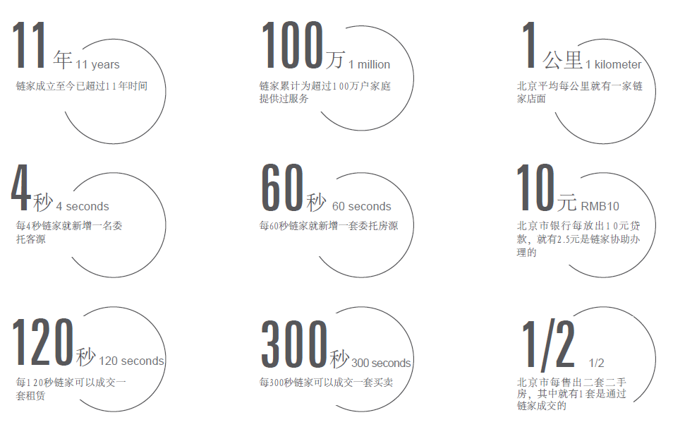
数
字
看
链
家

Slide 7
链家地产未来发展
Future development of Homelink

Slide 8
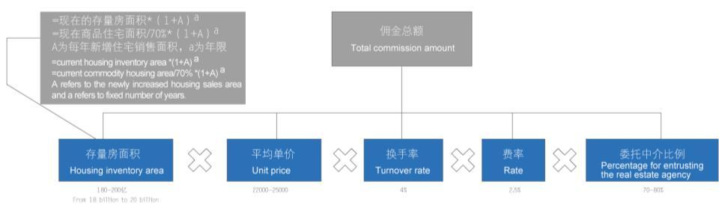
存量房市场未来发展
Future development of housing inventory market
未来5-10年，全国存量房年佣金规模将达3000-4000亿，北京存量房年佣金规模将达200亿。2015年中国住房抵押贷款将超16万亿，潜购需求依然旺盛，20-49岁之间比重接近60%。
In the future 5 to 10 years, the annual commission scale of national housing inventory and Beijing housing inventory will respectively reach 300,000,000,000 to 400,000,000,000 and 20,000,000,000. In 2015, China’s housing mortgage loan will exceed 160 billion and the potential buyers are still in large amount with the percentage between 20 and 49 approaching 60%.
2005-2010年，中国住房抵押消费贷款年均增长27%，2010-2015年，中国住房抵押消费贷款年均增长21%
Between 2005 and 2010, the annual increase rate of China's housing mortgage consumer loans will reach 27%.
Between 2010 and 2015, the annual increase rate of China's housing mortgage consumer loans will reach 21%.

Slide 9
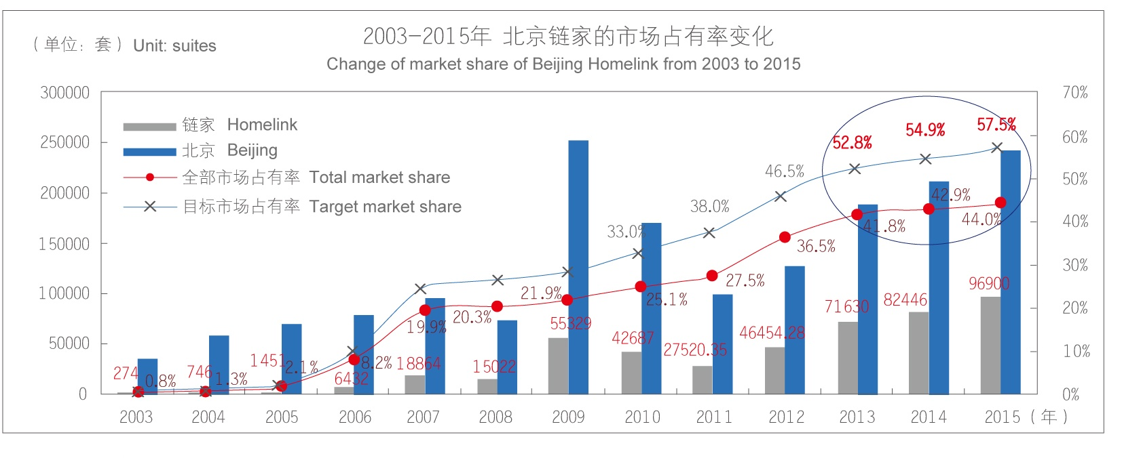
链家在一线单体城市的目标市场份额将超过50%
Homelink’s target market share in the first-tier cities will exceed 50%.

Slide 10
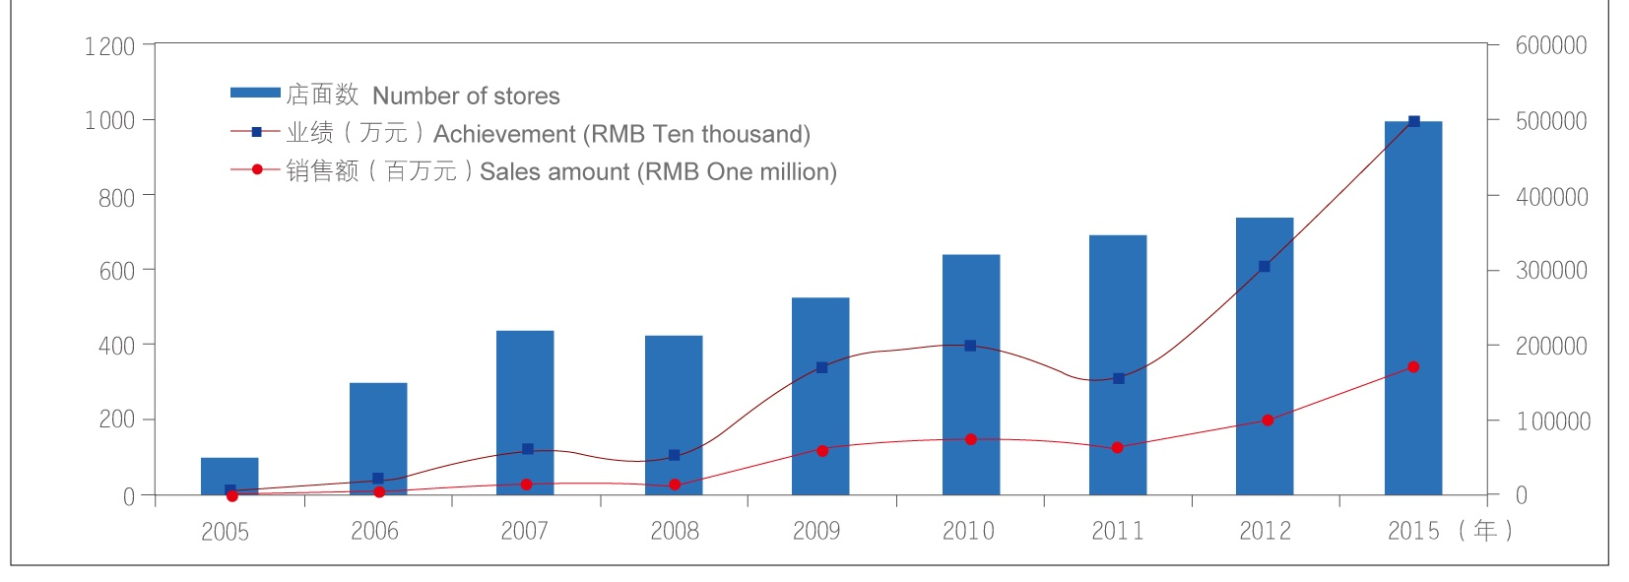
链家年佣金额将从30亿增长到50亿，全国链家佣金额将超过100亿 ，年交易额将超过1700亿
The annual commission amount of Homelink will increase to 5 billion from 3 billion. The national commission amount and the annual trading amount of Homelink will respectively exceed 10 billion and 170 billion.

Slide 11

体验链家
Experiencing Homelink
链家地产将继续秉承“为中国消费者提供最愉悦的不动产服务”的目标，不断创造“第一”，引领行业服务标准。
Homelink will continue to adhere to the goal of “providing most delighted real estate services for Chinese consumers” and constantly creates “the first” to lead industry service standards.

Slide 12
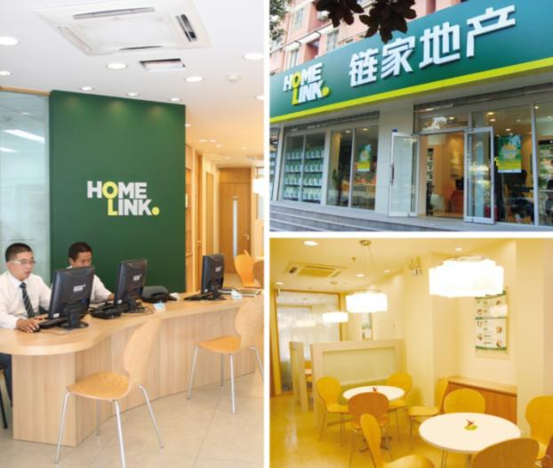
链家新形象
Homelink new image
2011年，链家地产斥巨资对店面进行升级改造，这是链家自主研发的第四代店面形象，旨在功能和感受上打造更好的客户服务体验，并提升以链家为代表的房地产经纪行业新形象。
优雅温馨的第四代店面为客户提供便捷服务
The elegant and warm fourth generation stores provide convenient services for the customer.
In 2011, Homeline spent a large amount of money to conduct upgrading and transformation to the chain stores. To give better customer service experience in function and feeling and upgrade the new image of real estate agency industry with Homelink taking the lead.

Slide 13
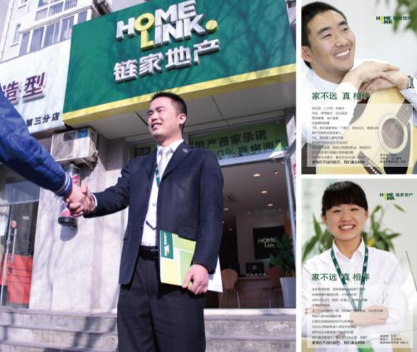
链家“心”服务
Homelink “whole-hearted” service
真诚、率直的经纪人用“心”服务
Honest and frank agents provide “whole-hearted” services.
链家有一群简单而又充满梦想的经纪人，他们凭借专业与执着，不断为客户提供更优质与贴心的服务，让房产交易变得轻松和愉悦！
A group of simple agents full of dreams in Homelink constantly provide better and warmer services to customers depending on their profession and persistence to make house transaction more relaxed and delighted.

Slide 14






2013年4月9日
链家地产北京公司正式推行：真服务五重保障
打造房产中介行业服务标准

Slide 15
链家致力于为客户提供“有标准”的服务
2013年
我们用“真实成交价”
开始定义什么叫“职业经纪人的市场行情揭示能力”；
用“嫌恶设施披露”定义什么叫“瑕疵信息揭示标准”
2011年
我们用“100%真房源”定义了什么叫“物件信息基本的交付标准”
2006年
我们用“资金监管”定义了什么叫“交易资金安全”
2013年
我们用“投诉单单公示”
开始定义什么叫“服务评价”
2013年
我们用“签约风险告知”
开始定义什么叫“基本交易风险揭示”
2003年
我们用“签三方约、不吃差价”定义了什么叫“透明交易”

Slide 16
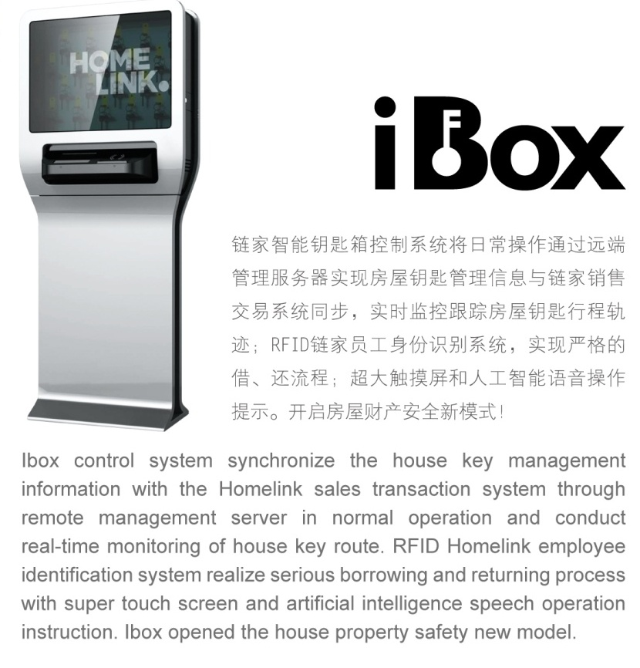
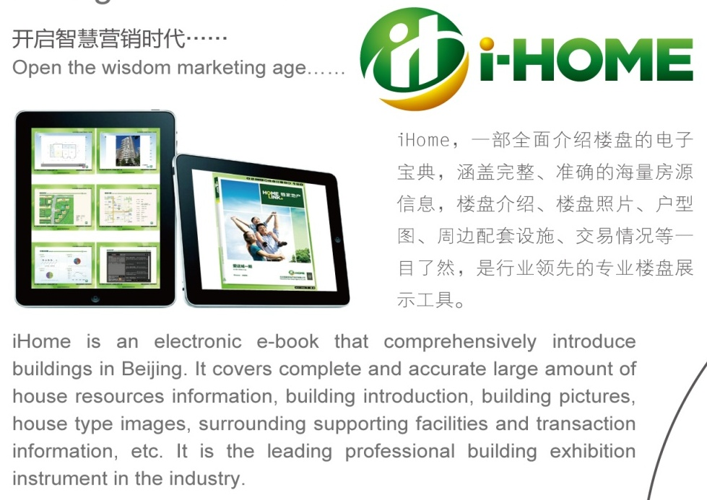

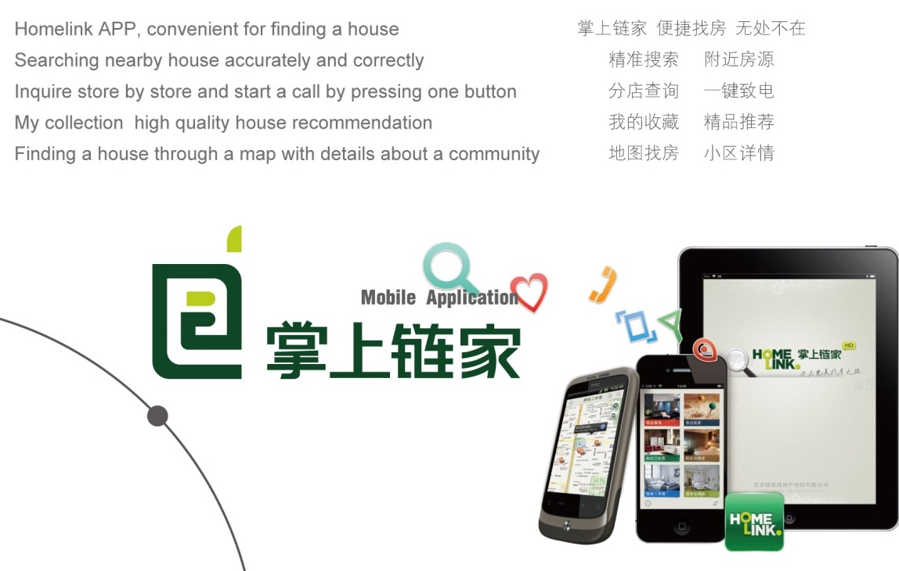
科技链家 Intelligent Homelink
开启智慧营销时代 Open the wisdom marketing age

Slide 17

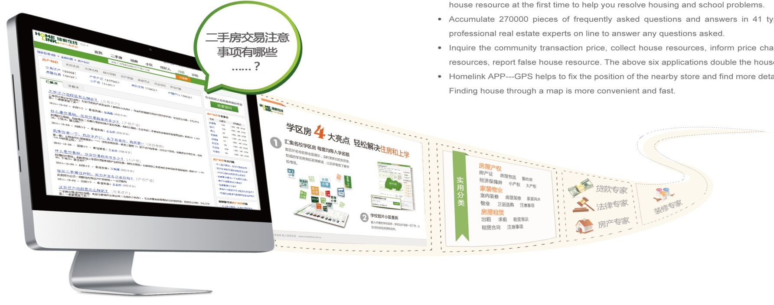
真房源金标准：国内首个践行100%真房源的二手房网站，房源真实存在、真实委托、真实价格，绝无重复。
独家公开客户看房、成交信息，打破行业“潜规则”，通过小区历史成交信息，为您提供更真实的市场预测，帮您进行购房决策。七种特色标签，帮您快速识别好房。
经纪人多维度评价房源、业主亲自描述房源特点，一房多评，让房子不再有秘密。
学区房频道汇集名校学区房，学校划片小区查询，购买资质评估，第一时间获学区房新房源，轻松解决住房和上学。
汇集41类270000＋条房产常见问题及解答，10000＋名房产专家随时在线，有问必答。
查询小区成交价、收藏房源、变价通知、订阅房源、对比房源、虚假房源举报，六个小应用让找房效率加倍。
掌上链家——GPS定位附近门店位置、全面的房源信息、地图找房更快更方便！

Slide 18

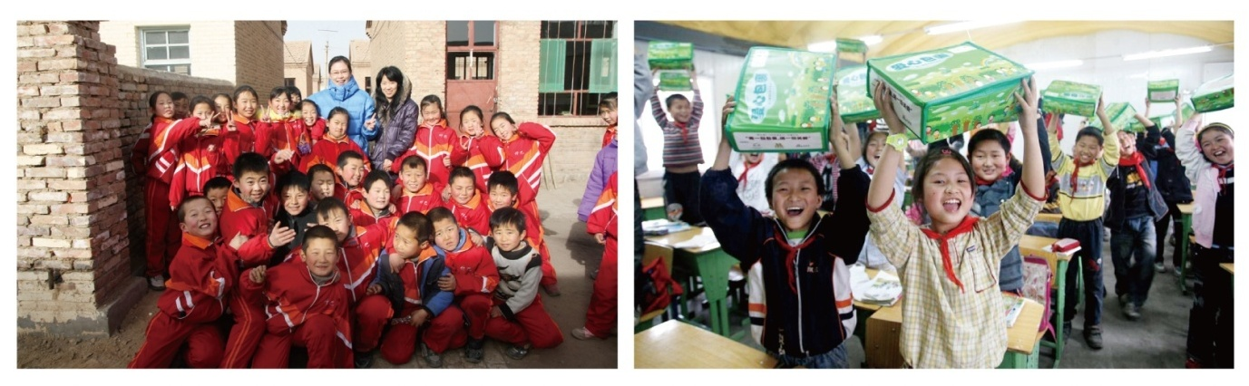
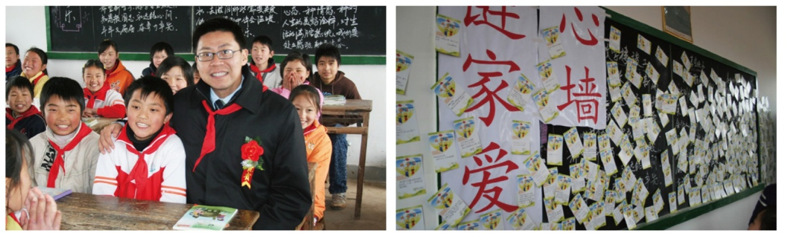
链家公益
Homelink public welfare
链家地产坚信社会公益重大意义，持续不断在教育、社区服务等领域开展公益事业。
Homelink firmly believes the significant meaning of public welfare and constantly develop public welfare in such fields as education and community service, etc.
2006年至今，链家希望小学：链家自2006年起，与中国青少年发展基金会合作，捐建希望小学。至今已经在安徽、内蒙和山西捐建了三所希望小学，之后也将每年捐建一所希望小学。
From 2006 till now，Homelink Hope Preliminary School
Since 2006, Homelink has cooperated with China Youth Development Foundation actively and donates Hope Preliminary School. At present, Homelink has established three Hope Preliminary Schools in Anhui, Inner Mongolia and Shanxi and it will donate a Hope Preliminary School every year in the future.

Slide 19

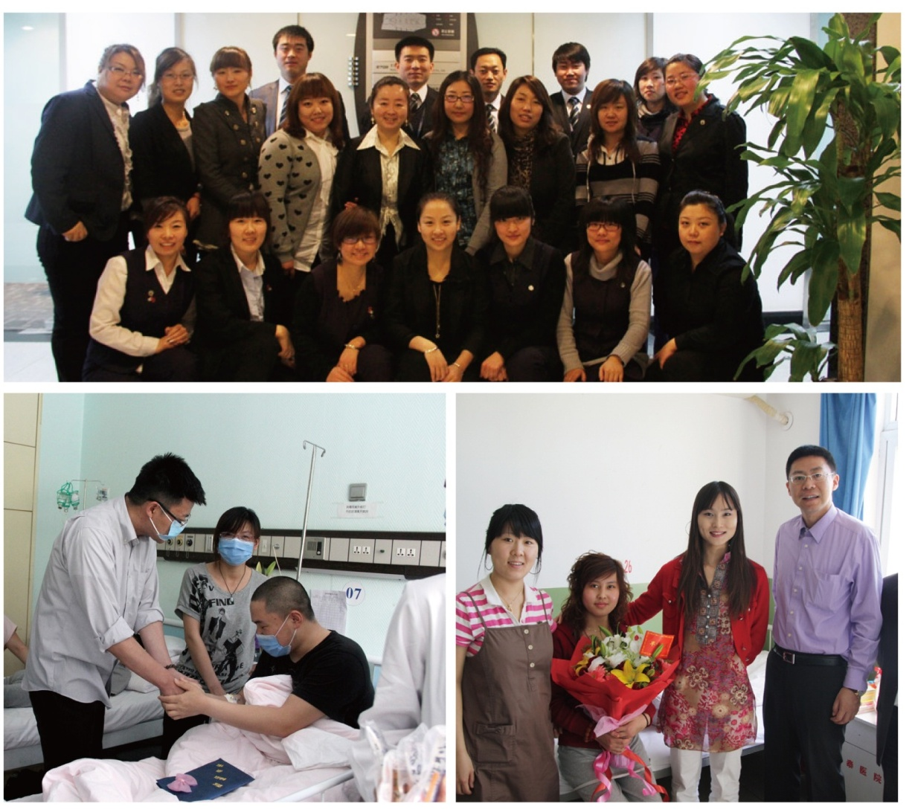
2006年，互助金
为提高员工的抗风险能力，链家地产成立互助金基金会，所有链家地产员工均加入基金会，享受互助金救助的权利。基金会成立至今，给上千位链家人的家庭送去了温暖与关怀。
In 2006, Mutual aid money
In order to improve the staff's anti-risk capability, Homelink established mutual aid money foundation. All the employees participated in the Foundation to enjoy the rights of assistance of the mutual aid money. Since its establishment, the Foundation had sent warm and care to thousands of Homelink families.

Slide 20


2011年，十万小时义工
链家联合北京市社区服务中心开展“十万小时义工”活动，为社区提供美化、绿化环保等服务。
In 2011, one hundred thousand hours’ volunteer
Homelink unites with Beijing Community Service Center to develop “one hundred thousand hours’ volunteer” activities to provide such services as community beatification and greening and environmental protection, etc.

Slide 21

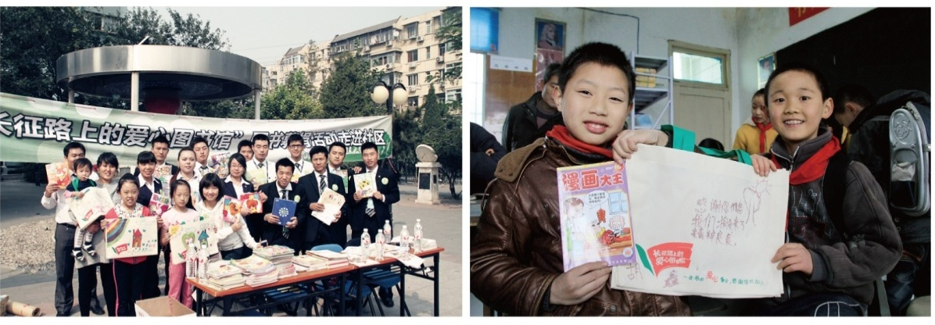
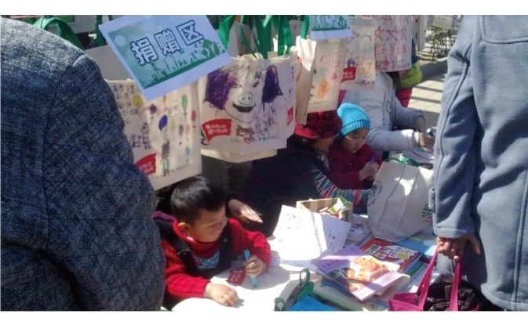
2011年至今，爱心图书馆
我们正在开展“长征路上的爱心图书馆”公益项目，计划募集图书35万册，为边远学校建立35所图书馆。目前由链家地产员工组成的义工队已经深入100多个社区开展图书募捐。同时，链家所有门店均开放为图书定点募捐处，随时接受捐赠。
From 2011 till now, loving library
We are developing the public welfare project of “Loving libraries on the way of Long March” and intend to contribute 350,000 books and establish 35 libraries for the remote school on the way of the Long March. At present, the volunteer team built by the Homelink employees has visited more than 100 communities for development of books contribution activities. At the same time, all the stores of Homelink is open as the contribution place for books and accept the contribution at any time.

Slide 22
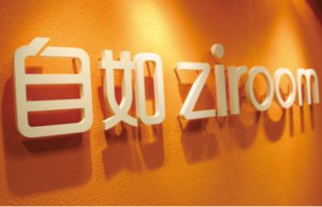
自如资产 Ziroom
自如资产于2011年在北京创立，是品质租房的代表品牌，其所有房屋均经过专业设计，实施统一装修、家居家电配置等，还提供保洁服务、维修服务等多项后期服务。如果入住3天内，有任何不满意，自如还会全额退款。租客只需要根据自己的需要考虑地段、小区环境等因素，甚至可以做到租金月付、零押金等，大大方便了对居住品质有要求的租客。相比市场上其他的租赁房源，很多租户认为自如是一种高性价比的品质代名词，因此自如的房源更为抢手。
Ziroom is established in Beijing in 2011 and it is the representative brand of quality renting. All the houses therein are professionally designed and are conducted with unified decoration and household electrical appliances allocation, etc. In addition, Ziroom provides such many later services as cleaning services and repair services, etc. If the tenant is unsatisfied with the house within 3 days of admission, Ziroom will return the rent in full. The tenant can only consider such factors as the section and community environment, etc, even they can pay the rent monthly without deposits, etc, which has greatly facilitated the tenants who have living quality requirements. Compared with other houses leased in the market, many tenants consider Ziroom has become synonymous with high quality. As such, Ziroom’s house will enjoy good rental.

Slide 23
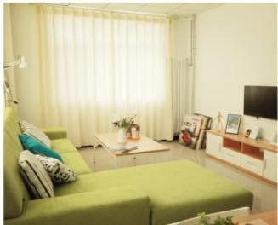
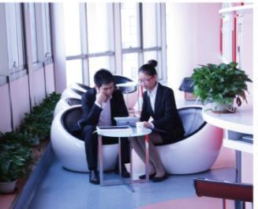
自如资产
第一期合租产品“自如·友家”已经面市；
同时，自如首个整栋租赁项目——将府公园自如寓也将于2012年12月面世。
短短一年时间，自如就有30000名自如客入住，他们来自于全球76个国家与地区。
自如管理资产价值超240亿，为房屋升级配置了超过5000台冰箱、6000台洗衣机、20000部空调、16000张床。
自如每月400热线话量超20000、月保洁超8000套、月维修超3000单。 自如业务以北京为主，未来将拓展到更多城市。虽然成立时间不长，但业务发展却非常迅速，业务规模、客户数量都在以每月超过40%增速发展，目前已经成为中国租赁市场上唯一具有品牌意义的公司。

Slide 24


